Slide 1
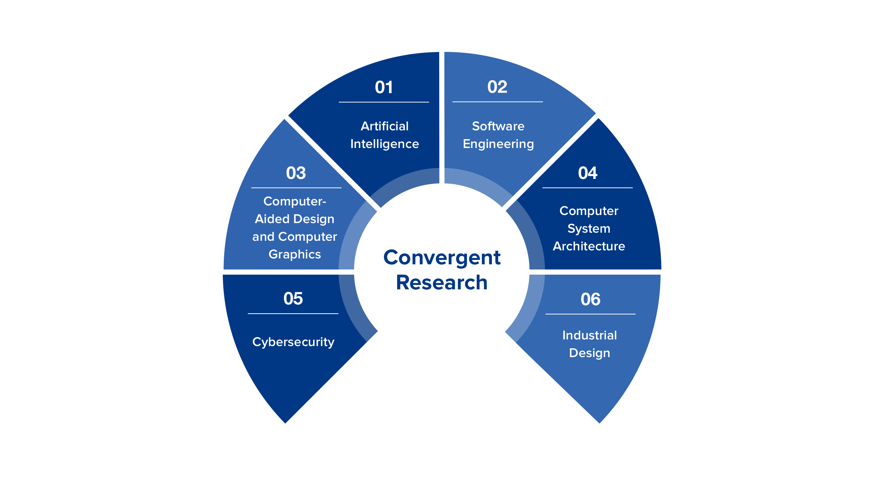
About Us
Best Global Universities
for Computer Science (2020)
# 11
Research influence in Computer Science worldwide
*Essential Science Indicators(2020)
# 22
Key Facts
History | Since 1958
Students | 2,109 undergraduates 1,649 graduates
Faculty | 250 full-time faculty 70 post-docs & 127 supporting staff
Honors | 3 Turing laureates (honorary professors) Distinguished Paper Awards (AAAI, ACM SIGSOFT, etc) Top Design awards (Reddot, iF Design Awards, etc)
Research | 14 National & Provincial Key Laboratories & Research Centers for Engineering Technologies ~380 Million annual research funding (in RMB)
Subject Rankings:
Computer Graphics & Visualization:
Top 1 worldwide
Artificial Intelligence:
Top 6 worldwide
Computer Security:
Top 2 in Asia & Top 1 in China
*Computer Science Rankings (2011-2021)

Slide 2
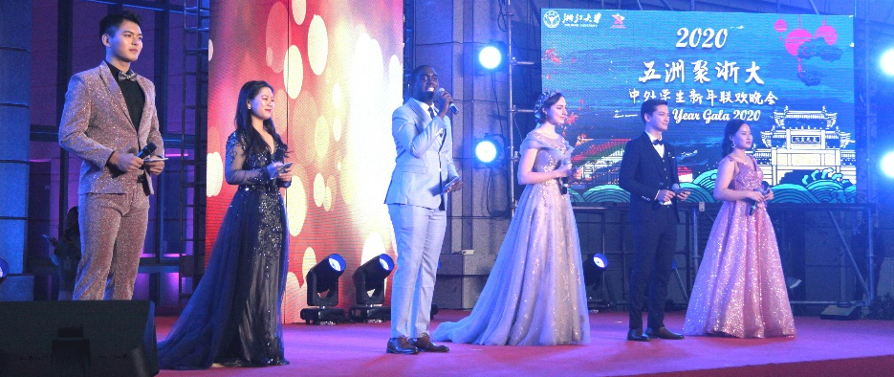
Academic Programs
English Programs
Scholarships
Chinese Government Scholarships
Tuition waived
Accommodation on campus
Monthly stipend and medical insurance
Computer Science and Technology
Applications
December–March
Submit online application
Contact prospective supervisors for provisional
acceptance (highly encouraged)
Software Engineering
Cyber Security
More Information
Duration
Master: 2-3 Years; PhD: 3-4 Years
RA & TA and other need-based
scholarships also available.
Fully supported by
CSC Scholarships

